Slide 1
Persistence
easter egg #1

Slide 2
What is persistence?
Malware behavior can be grouped in two ways
absolutely destroy the system
stay on the system, hide from everything, and covertly extract information
Persistence is an act of the latter behavior
Persistent malware will try to hide itself and achieve persistence to continue even after a reboot

Slide 3
Legacy
Windows Registry was an old-fashioned way of malware to hide onto the system
HKEY_CURRENT_USER\Software\Microsoft\Windows\CurrentVersion\Run
Anything in here would execute whenever a specific user logged in (whichever user the malware was run on)

Slide 4
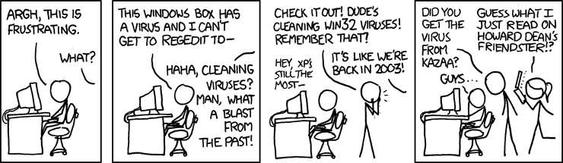
An xkcd comic on malware persistence

Slide 5
Legacy
If it somehow gains admin privileges, it can edit its way into the HKLM registry tree
HKEY_LOCAL_MACHINE\SOFTWARE\Microsoft\Windows\CurrentVersion\Run
In this case, the malware will run whenever the system boots

Slide 6
Nowadays
Malware has different ways of embedding itself
Antimalware covers common spots for you
Malwarebytes
Avast
many, many other free antimalware for you to try

Slide 7
It’s a great thing that cybersecurity’s importance is better recognized these days. People now understand the need for antimalware.
Me

Slide 8
Chapter 1:
Task Scheduler
Annoying as %$#@#

Slide 9
What are they?
They run specific tasks at a specific schedule
Purposes:
Maintenance
Updates
Security
Malicious intent

Slide 10
So basically...
Run tasks at specific schedules can mean
Upon an event
User login
Program opened
etc
After x amount of time
etc
Why are we learning about them?
Usually only for system maintenance
Hackers can take advantage of them

Slide 11
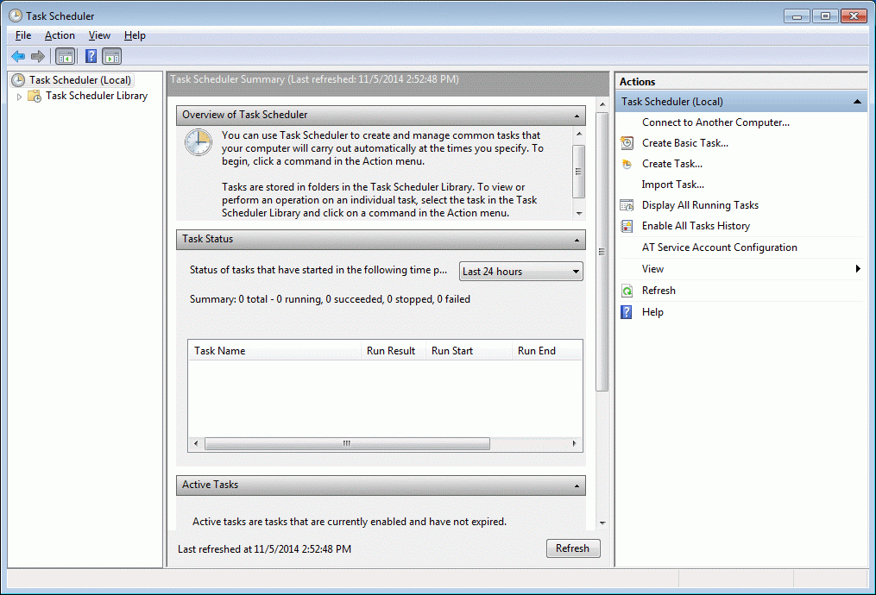
A Peek at Task Scheduler
Search “task scheduler”
or
Win+R: taskschd.msc

Slide 12
What does it do?
“Task Status” Section does not work as it says it does so ignore it
“Active Window” shows tasks that have been started before/ones that are waiting to be started
You can create tasks on the right side through a helpful wizard
On the right side it also allows you to “Show Hidden Tasks” under the “View” menu
Make sure this is checked

Slide 13
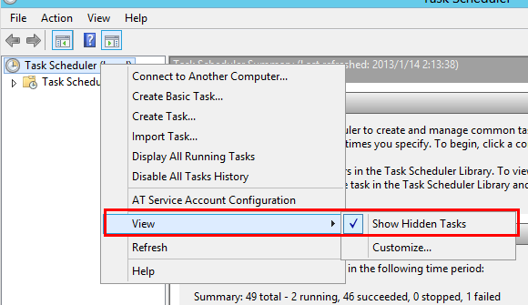
Showing hidden tasks

Slide 14
Finding Bad Tasks

Slide 15
What to do?
First identify a bad task
This requires your “CyberPatriot deduction skills”
Recommendation
See if you can find an obviously malicious task
Configure everything. When you restart your computer, look for any changes to your settings (or the points you gained)- if you find a change, this MAY be indicative of a scheduled task
There could be other reasons why, but in these next examples we can assume that this is the case

Slide 16
How do I find a malicious task?
Your main method of searching through the many innocent tasks is by looking at the name, the trigger, and the action upon trigger of each active task
You can also try out third-party software, just make sure they are trustworthy

Slide 17
Summary: look for malicious tasks
Manually
Look at the attributes for each tasks
This includes name, trigger type, and action performed
While this is a pain, this is the simplest method to do so

Slide 18
Chapter 2 Section 1:
GPEDIT
Although not technically malware persistence, technically a form of persistence

Slide 19
GPEDIT
GPEDIT is like LSP but on steroids
Capable of preventing users from changing settings - grayed out boxes
There are literally A TON OF SETTINGS
Most of these settings are not security related
Most of the security settings can be easily determined through common sense
Notes:
GPEDT does not come with windows 10 home edition if you want to enable it https://windowsreport.com/enable-gpedit-msc/

Slide 20
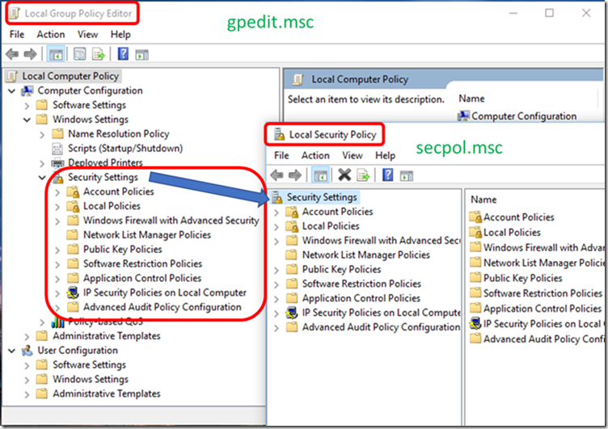
Group Policy Editor
The Group Policy Editor is the built in tool for Windows to manage your computer’s policies
Win+R: gpedit.msc
You’ll note that LSP is a part of the overall Group Policy - you can enforce LSP here so it cannot be changed

Slide 21
Some examples
Computer Configuration > Administrative Templates > Windows Components > Autoplay Policies
"Turn off Autoplay" - Enabled for All Drives
Computer Configuration > Administrative Templates > Windows Components > Remote Desktop Services > Remote Desktop Session Host > Connections
"Allow users to connect remotely by using Remote Desktop Services" - Disabled
// * IF REMOTE IS NOT REQUIRED, else Enabled

Slide 22
More examples
User Configuration > Administrative Templates > Control Panel > Personalization
"Enable screen saver" - Enabled
User Configuration > Administrative Templates > Control Panel > Personalization
"Password protect the screen saver" - Enabled
Computer Configuration > Administrative Templates > Network > Network Connections > Windows Firewall
For all profiles, set "Windows Firewall: Protect all network connections" to Enabled

Slide 23
Even more examples
Computer Configuration > Administrative Templates > Windows Components > Remote Desktop Services > Remote Desktop Session Host > Security
"Require secure RPC communication" - Enabled
"Require user authentication for remote connections by using Network Level Authentication" - Enabled
Computer Configuration > Windows Settings > Security Settings
GPEDIT LSP

Slide 24
Woah wait that’s too much
Where can I go for more settings?
https://www.stigviewer.com/
View settings rated on a scale of severity
Or just google “gpedit hardening forum” or something similar
https://gpsearch.azurewebsites.net/
The search engine for GPEDIT settings

Slide 25
After changes...
Don’t forget to either restart your computer OR run “gpupdate /force” (as a command)
This will ensure that GPEDIT changes are made to the computer

Slide 26
Chapter 2 Section 2:
LGPO
LGPO tool
Can save you fifteen percent
It’s a bad haiku
Notes:
Save this section for the end if running out of time

Slide 27
LGPO (Local Group Policy Object)
LGPO is a tool for importing and exporting group policy settings
Search online and download
LGPO is a command-line utility (you run it like a command)

Slide 28
LGPO Usage Details
Download LGPO here: https://www.microsoft.com/en-us/download/details.aspx?id=55319
If you drag LGPO.exe to your C:/Windows/System32/ folder, you can use it from cmd
System32 is included in Window’s PATH variable
PATH specifies where to looks for executables
That’s why you can run “cmd” without specifying the full path

Slide 29
Making a Backup
Open cmd with admin privileges and go to the directory that holds LGPO.exe
Type: lgpo /b <path where u want to save the policy>
Example: lgpo /b “%USERPROFILE%\Desktop”
This will make the backup folder on your current user’s desktop

Slide 30
Applying your backup
Open cmd with admin privileges and go to the directory with LGPO.exe and your backup
Type: LGPO /g <path of the folder with the name>
Review: what should you do after changes?
FInish by running: gpupdate /force
This will force an update of GPEDIT and enforce the settings on the computer

Slide 31
Chapter 3: Event Logs
I can see everything you do, Jon
Do not resist

Slide 32
thx
If you have any questions about using LGPO, ask one of the instructors in class.
A classroom post on LGPO will be posted some time this week

Slide 33
What is event viewer?
The event viewer is a tool to view all event logs recorded in the Windows Event Log. You can view event logs on a local or remote machine
Audit policies need to be set, and Windows Event Log service needs to be enabled

Slide 34
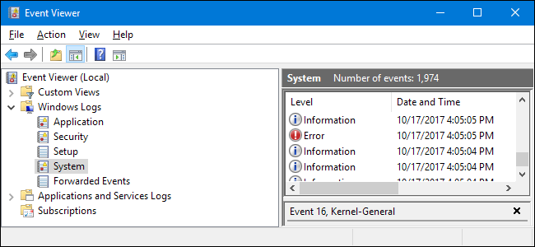
Where is event viewer?
Access event viewer either by searching or by Win+R (eventvwr.msc)

Slide 35
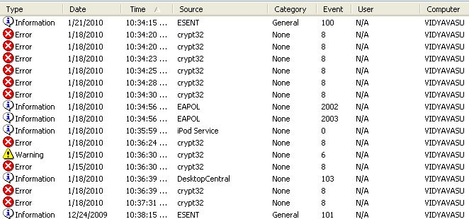
How is event viewer?
Categories
Application Log
System Log
Security Log
Directory Service log
DNS Server log
File replication service log
Types
Information
Warning
Error
Success Audit
Failure Audit

Slide 36
Why is event viewer?
Aggregated logs
Audit policy > event log

Slide 37
How to read
Each log will have their own headers that provide information on certain aspects during the time of the log, in addition to the information being recorded
date
the user logged in
the source
etc.

Slide 38
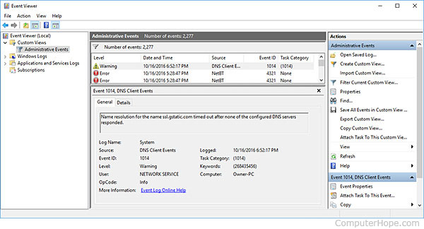
Metadata of logs

Slide 39
Event IDs
Identify a type of event - search online for ID #
Some of the few of the many IDs:
4723,4724 - Change Password
4720,4726,4738,4781 - Delete, Change Accounts
4608,4609 - Startup, Shutdown
4613 - Clear Security Log
4616 - Change System Time
4617 - Unable to Log
4714,4705 - Privilege assigned or removed
4708,4714 - Change audit policy
4717,4718 - System access granted or removed
4739 - Change domain policy
16390 - Administrator account lockout
4727-4730,4731-4734,4735,4737,4784,4755-4758 - Group changes
4624,4636,4803,4801 - Account logons
4625,4626,4627,4628,4630,4635,4649,4740,4771,4772,4777 - Logon failures (KEYWORD: Audit Failure )
4672 - Admin account logons
4698 - Schedule new job
4656 - Access refused to object
3004,3005 - Windows defender finds something
4664 - Create hard link to audited file
865 - Software restriction triggered
1000 - Application Error ( Event Level: CHECKMARK "Error" )
1002 - Application Hang ( Event Level: CHECKMARK "Error" )
1037 - Protected Mode violation
7031 - Service terminated unexpectedly
4697 - Install a Service
4663 - Access audited file

Slide 40
Chapter 4: Backdoors
Spooky scary doors
Who knew doors were dangerous

Slide 41
Backdoors?
Methods of connecting to computer, bypassing all security policies in place
Intended for troubleshooting but can be used maliciously

Slide 42
Types
Passive/dormant
Harder to find, harder to trigger unless time or event based
Active
Easier to find, but deadlier since it’s already listening for a connection

Slide 43
Searching for them
Antimalware is generally great at finding them (not 100% of the time, however!)
If passive/dormant, your only hope is antimalware programs or manually searching and patience
If active, you can check ports and task manager for suspicious processes

Slide 44
Finding active backdoors
netstat -aon
lists all network connections and the process ID (PID) as well as the IP address and port numbers in numerical order
netstat -anbo
needs admin cmd
does netstat -aon but also lists processes’ names
task manager
view Details tab for a sketchy process name or description

Slide 45
Backdoor schools of thought
Stay on the computer as long as possible
Two methods
One is to pretend to be harmless
Random name like “ComputerHelper.exe”
Windows exe name similarity like “system.exe”
The true Windows process is System (capitalized, without a .exe)

Slide 46
Backdoor schools of thought
Another is to hide self as best as possible - redirects computer functions to itself to obtain information
These types of backdoors are also called rootkits, and they are very hard to find
They can hide from task manager, netstat, and registry
Notes:
did you find all 10 easter eggs

